Slide 1
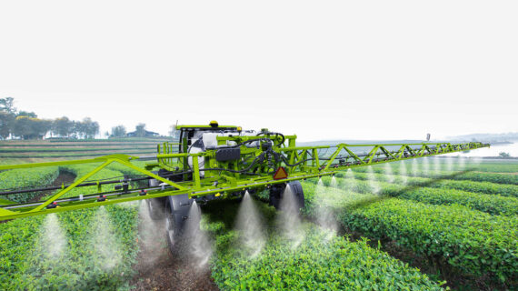
AquaSens
AI-Powered Irrigation System
Smart Irrigation
Prediction System
Leveraging Machine Learning for Sustainable Water Management in Agriculture
Author
Institution
Supervisor
Houssem Eddine Chaouch
Sousse Polytechnic School
Dr. Fatma Sbiaa

Slide 2
Agenda
01
Problem & Objectives
02
Dataset Overview
03
Methodology
04
Model Selection & Results
05
Optimization & Final Performance
06
System Architecture
07
Key Achievements & Impact
08
User Interface & Demo
09
Limitations & Future Work
10
Conclusion & Q&A

Slide 3
Problem & Objectives
Problem Statement
Project Objectives
Agricultural Water Inefficiency: Traditional irrigation methods lead to significant water waste, over-irrigation, and suboptimal crop yields.
1
Predictive Modeling
Develop ML model to predict irrigation needs with Low, Medium, High classification
Resource Scarcity: Mediterranean regions face increasing water stress due to climate variability and limited resources.
2
Accuracy Target
Decision Gap: Farmers lack data-driven tools to make informed irrigation decisions based on environmental conditions.
Achieve >95% accuracy with excellent minority class detection
Regional Context
3
Production System
Tunisia and Mediterranean regions require precise irrigation planning due to climate variability and water scarcity.
Build full-stack web application for practical deployment
1

Slide 4
Dataset Overview
Dataset Source
Features & Target Variable
Author:
Arif Miah
Soil Features (4)
Crop Features (3)
Platform:
Kaggle
Target Variable
Name:
Irrigation Water Requirement Prediction
Soil_Type
Crop_Type
Soil_pH
Crop_Growth_Stage
Irrigation_Need
Soil_Moisture
Season
3 Classes
Data Quality
Organic_Carbon
Management (2)
Low
No missing values detected. Dataset is complete and ready for modeling.
Weather Features (5)
Medium
Mulching_Used
High
Temperature_C
Previous_Irrigation_mm
Humidity
Regional (1)
Rainfall_mm
Sunlight_Hours
Region
Wind_Speed_kmh
2

Slide 5
Methodology
1
Data Preprocessing
2
Train-Validation-Test Split
3
Candidate Models
Tree Models
70-20-10 Strategy
Decision Tree
Binary encoding for categorical features
Training:
7,000 (70%)
Interpretable, handles mixed data types
Validation:
2,000 (20%)
KNN Model
Test:
1,000 (10%)
Random Forest
One-hot encoding + StandardScaler
Ensemble robustness, reduces overfitting
Stratification
Features Selected
Class distribution preserved across splits
K-Nearest Neighbors
16 features after dropping 4
Distance-based, non-parametric
4
Evaluation Metrics
Accuracy
Precision
Recall
F1-Score
Overall correctness
Positive predictive value
Sensitivity, hit rate
Harmonic mean
3

Slide 6
Model Selection & Results
Validation Performance Comparison
Model | Validation Accuracy | High Precision | High Recall | High F1-Score
Decision Tree | 99.25% | 93.94% | 92.54% | 93.23%
Random Forest | 96.55% | 100.00% | 22.39% | 36.59%
KNN | 74.10% | 47.06% | 11.94% | 19.05%
Selected Model: Decision Tree
Decision Tree Confusion Matrix
Highest Overall Accuracy: 99.25% validation, 99.70% test
Validation Set (2,000 samples)
Excellent High Class Recall: 92.54% detects most critical irrigation cases
 | Predicted Low | Predicted Medium | Predicted High
Actual Low | 1173 | 0 | 0
Actual Medium | 6 | 750 | 4
Actual High | 0 | 5 | 62
Balanced Performance: Superior metrics across all classes
Interpretability: Provides clear decision paths for transparency
Efficiency: Fast training and prediction, suitable for real-time use
Only 15 errors out of 2,000 samples (0.75% error rate)
4

Slide 7
Hyperparameter Tuning & Final Performance
Grid Search Optimization
Final Test Results (n=1,000)
Search Space
99.70%
94.12%
144 combinations tested across 5 hyperparameters
Test Accuracy
High Recall
Optimization Metric
3 errors / 1,000 samples
32/34 correct detection
F1-macro score for balanced performance
100%
99.74%
Low Recall
Medium Recall
Best Parameters
586/586 perfect score
379/380 correct
Criterion:
Entropy
Class Weight:
{0:1, 1:1, 2:3}
Test Confusion Matrix
Min Samples Leaf:
5
 | Predicted Low | Predicted Medium | Predicted High
Actual Low | 586 | 0 | 0
Actual Medium | 0 | 379 | 1
Actual High | 0 | 2 | 32
Max Depth:
None
Min Samples Split:
2
Minority class (High) detection: 94.12% recall — critical for preventing crop water stress
5

Slide 8
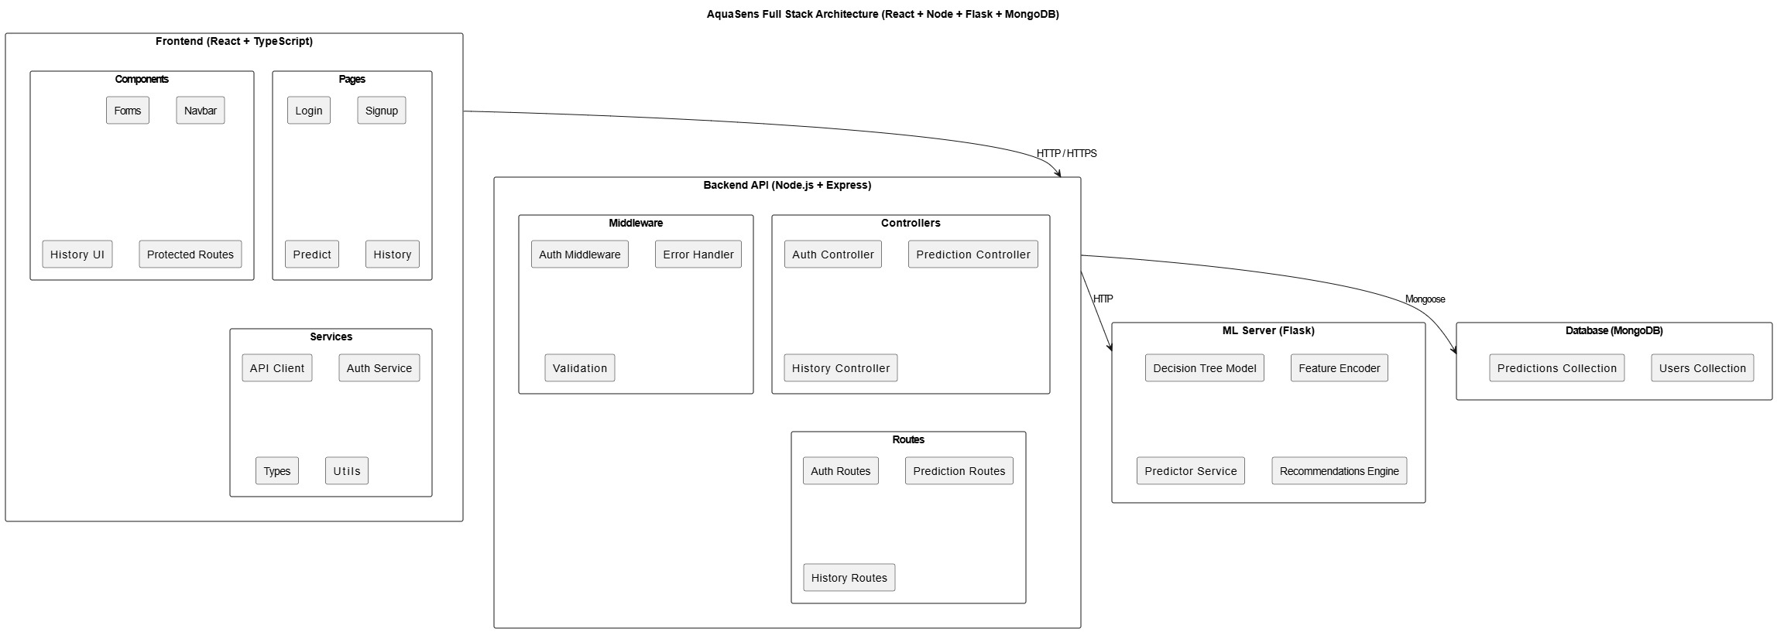
System Architecture
6

Slide 9
Key Achievements & Impact
1
Exceptional Accuracy
4
Full-Stack Implementation
99.70% test accuracy with only 3 errors out of 1,000 samples
Complete web application with React frontend, Node.js backend, MongoDB
Exceeds target of >95% by significant margin
Production-ready system with authentication
2
Critical Class Detection
5
Interpretable AI
94.12% recall for High irrigation — prevents crop water stress
Transparent decision paths explain every prediction
32 out of 34 high-need cases correctly identified
Builds user trust and enables debugging
3
No Overfitting
6
Production Ready
Test performance (99.70%) exceeds validation (99.25%)
Deployment-optimized with model persistence, API design, error handling
Excellent generalization to unseen data
Scalable architecture with security features
Practical Impact on Agriculture
Water Conservation
Crop Health
Educational Tool
Optimizes usage, reduces waste, preserves resources
Prevents stress, improves yields, enhances quality
Demonstrates AI in agriculture, trains farmers
7

Slide 10
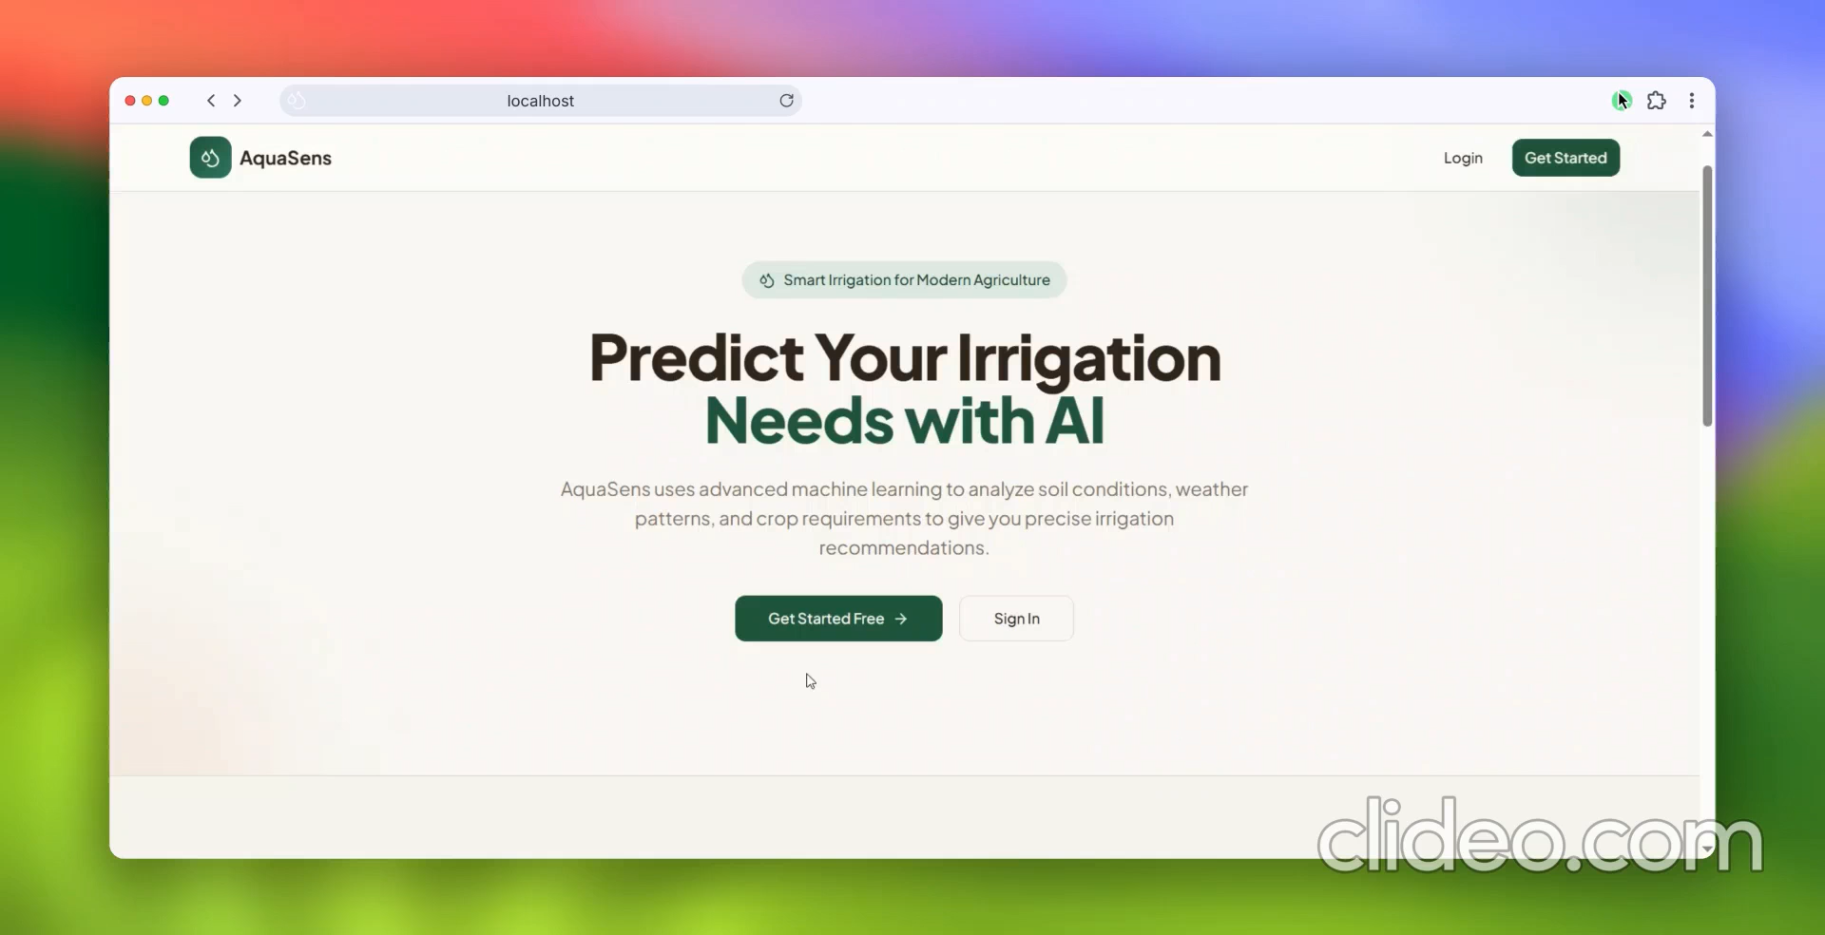
User Interface & System Demo
8

Slide 11
Limitations & Future Work
Current Limitations
Future Enhancements
Region-Specific Dataset
1
Real-Time Weather APIs
Training data may not generalize to all geographical regions with different climates
Integrate live weather data for automatic irrigation adjustments
2
Mobile Application
No Real-Time Weather
Native iOS/Android apps for field accessibility
System relies on user input, not connected to live weather APIs
3
Additional Crop Types
Static Model
Expand dataset to include more crop varieties and growth stages
Model doesn't auto-update with new data; requires manual retraining
4
Ensemble Models
Combine multiple algorithms for improved robustness
5
Cloud Deployment
Deploy on AWS/Azure with auto-scaling and monitoring
Note: Despite limitations, current system provides high-value, actionable recommendations with 99.70% accuracy.
9

Slide 12
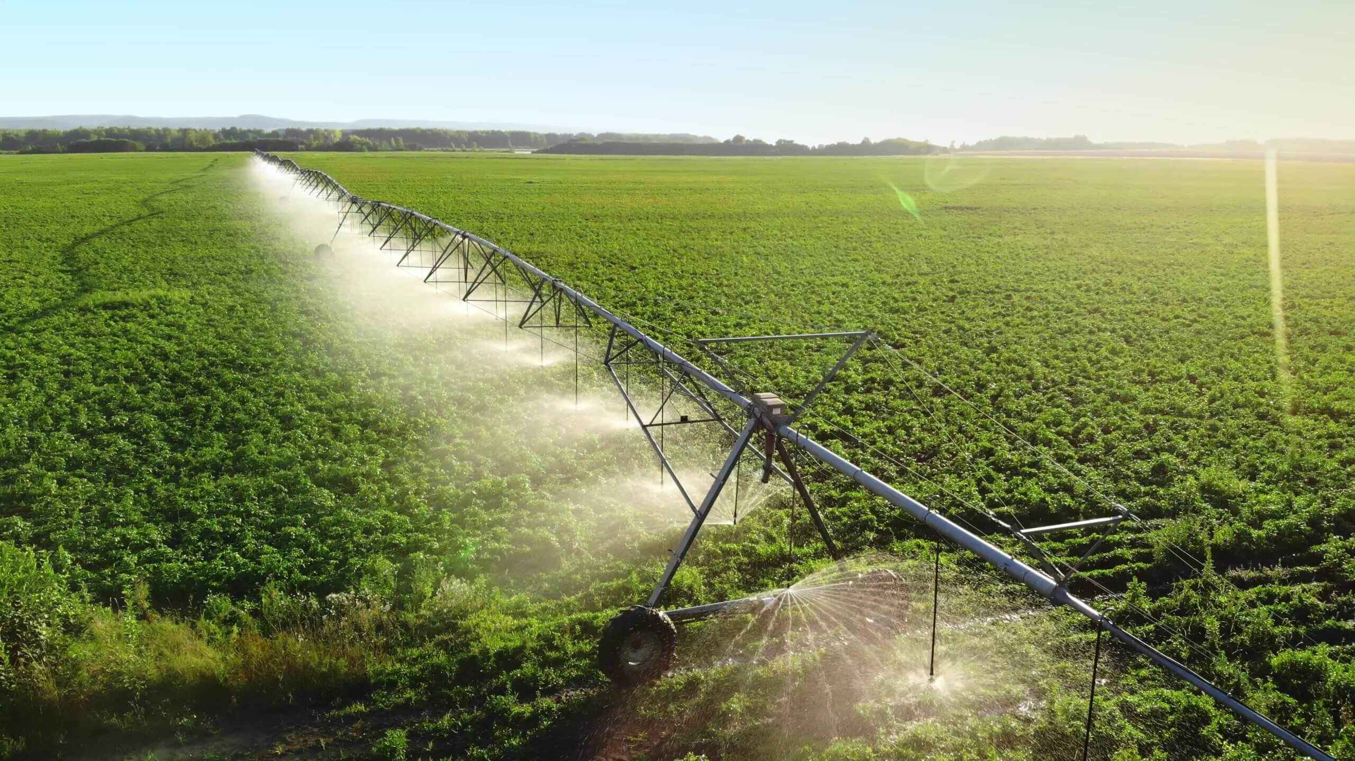
AquaSens
Conclusion
Key Accomplishments
Technical Achievements
Developed 99.70% accurate irrigation system exceeding target
99.70%
94.12%
Demonstrated practical AI application in agriculture
Achieved balance between accuracy & interpretability
Test Accuracy
High Recall
Created foundation for smart agriculture solutions
10k+
3
Dataset Samples
Test Errors
Thank You
Questions & Discussion
Houssem Eddine Chaouch
Sousse Polytechnic School
GL BI DS 2024-2025
10

